Slide 1


Polymer structure
UANL: Facultad de Ingeniería Mecánica Eléctrica
Name: Juan José González Salinas. Student number: 1820234.
Career: IAE. Semester: January-June 2018.

Slide 2
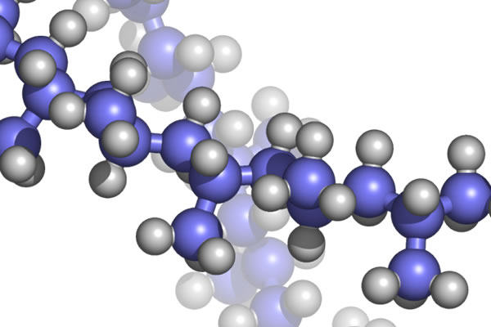

Definition of polymer
Polymers are a large molecule made by chains of monomers and usually have melting and boiling points. Besides this, polymers have high molecular masses because the molecules consist of many monomers.

Slide 3
Examples of polymers
Polymers may be divided in two sections
Natural polymers
Silk
Rubber
Cellulose
Wool
Amber
Keratin
Synthetic polymers
- PVC (polyvinyl chloride)
- Polystyrene
- Synthetic rubber
- Silicone
- Polyethylene
Nylon

Slide 4
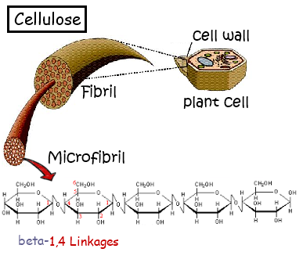

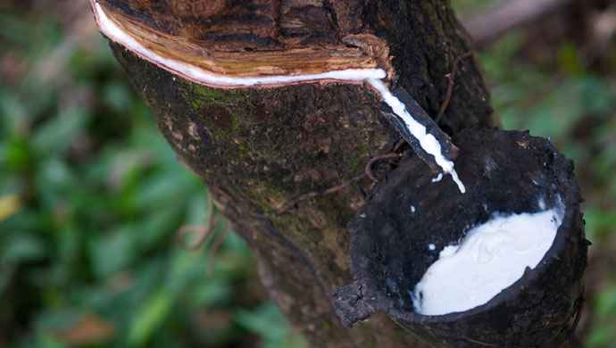
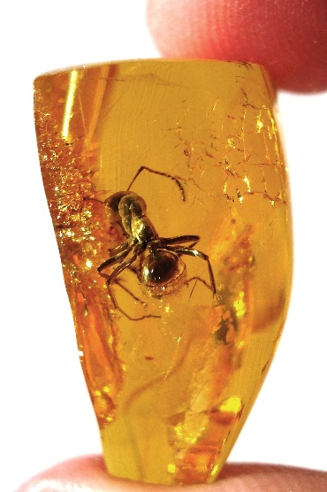


Natural polymers

Slide 5
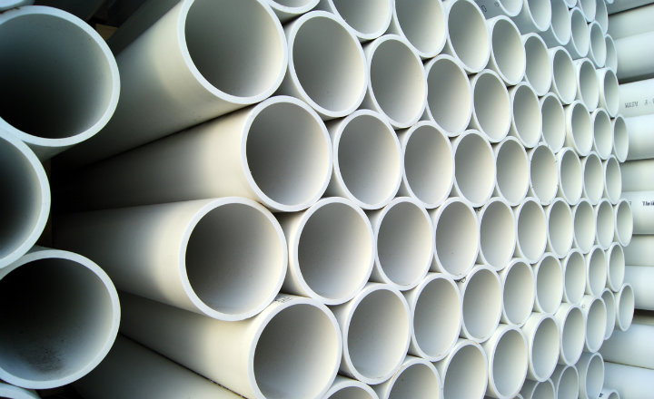
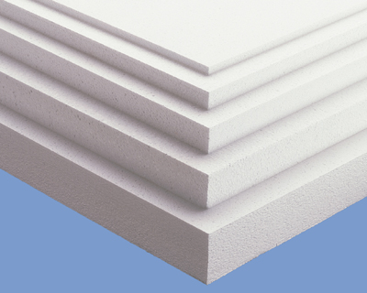
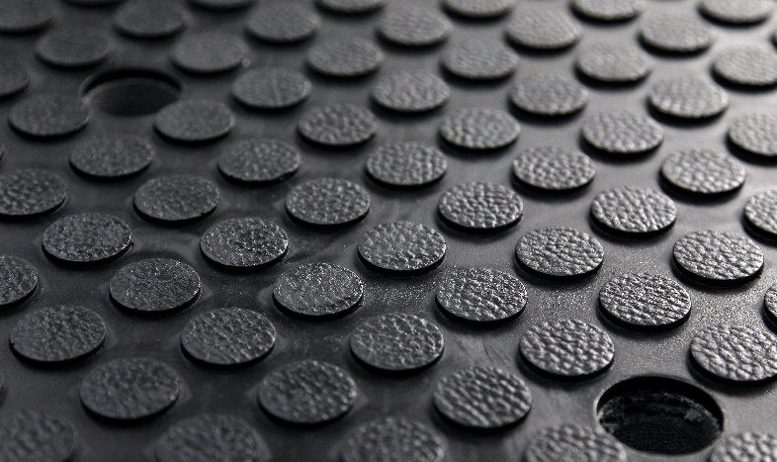
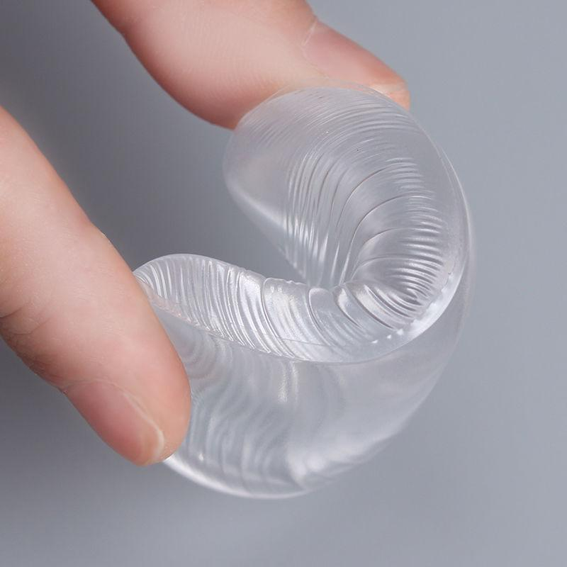
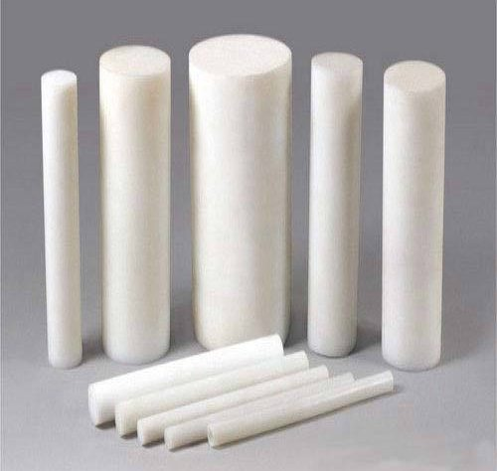
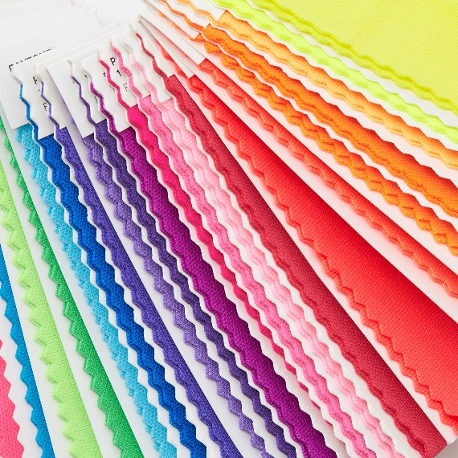
Synthetic polymers

Slide 6
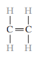
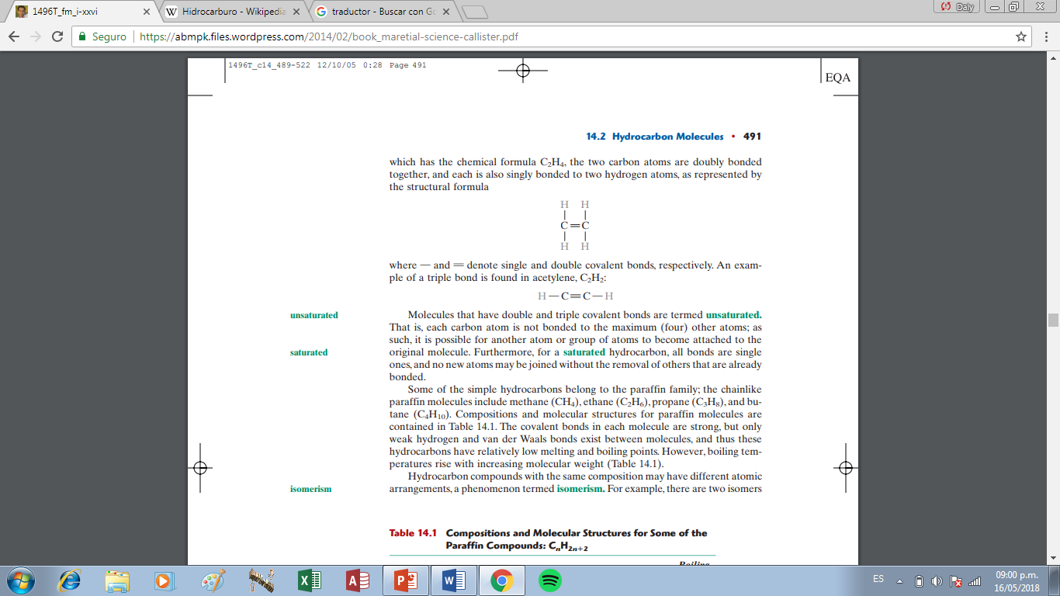
Hydrocarbon molecules
Many organic materials are hydrocarbons, it means that they are composed of carbon and hydrogen.
The intramolecular bonds are covalent. Each carbon atom has four electrons that may participate in covalent bonding, whereas every hydrogen atom has only one bonding electron.
Example: C2H4 (ethylene)
C2H2 (acetylene)
Double
bonding
Triple bonding

Slide 7
Some important terms
Unsatured: Molecules that have double and triple covalent bonds.
Satured: In a satured hydrocarbon all bonds are single ones and there can’t be new joined atoms without the removal of others that are already bonded.
Isomerism: Property by which certain chemical compounds being formed by the same elements in the same proportions have different properties because the atoms are placed in different positions of the molecule.
Polymerization: A chemical reaction in which two or more molecules combine to form larger molecules that contain repeating structural units.

Slide 8
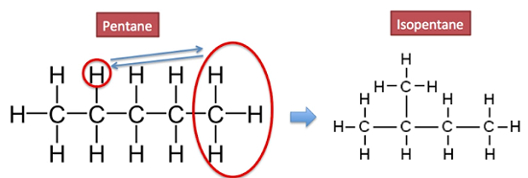
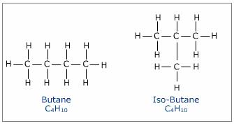
Examples of isomers

Slide 9
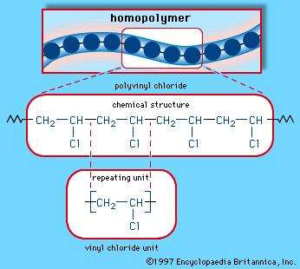
Polymer molecules
Because the polymers are huge compared to other molecules they are often referred to as macromolecules and these long molecules are composed of structural entities called repeat units
Example:

Slide 10
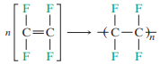
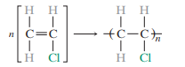
THE CHEMISTRY OF POLYMER MOLECULES
If we want to make a representation of a large polymer we can use repetitions of monomers with a subscript given by “n” to avoid writing all the polymer.
For example, the tetrafluoroethylene monomer, can polymerize to form polytetrafluoroethylene (PTFE) (teflon) as follows:
The vinyl chloride monomer is a slight variant of that for ethylene, in which one of the four H atoms is replaced with a Cl atom. Its polymerization is represented as

Slide 11
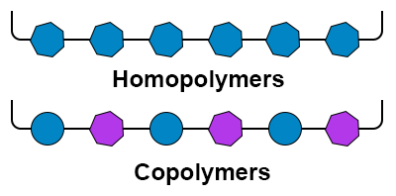
THE CHEMISTRY OF POLYMER MOLECULES
If the repeating untits along the chain are all the same we can say that we have a homopolymer.
Chains may be composed of two or more different repeat units, in what are termed copolymers.

Slide 12
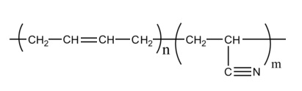
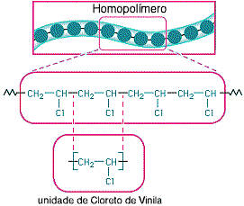
Examples
Nitrile rubber
Vinyl chloride

Slide 13
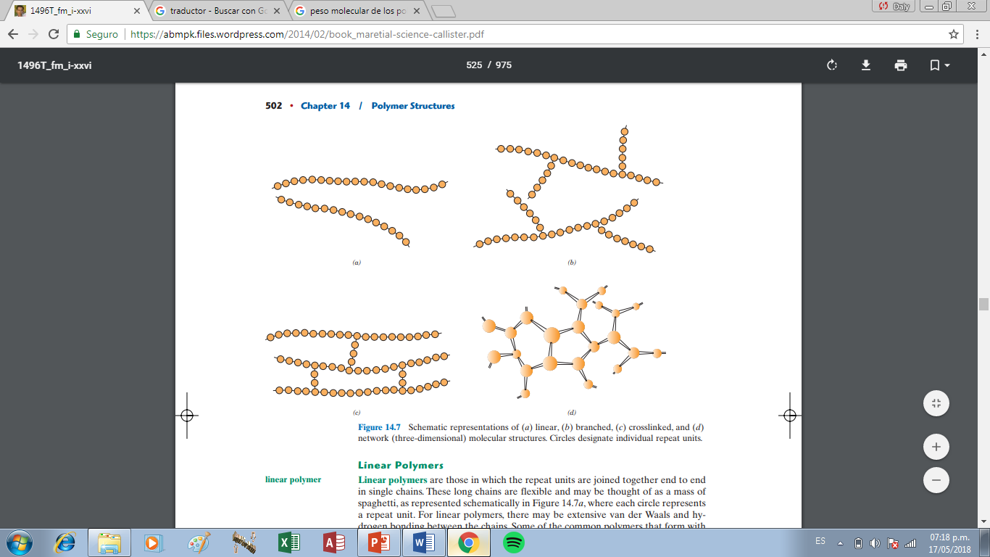
MOLECULAR STRUCTURE
There are 4 types of molecular structure:
Linear Polymers
Branched Polymers
Crosslinked Polymers
Network Polymers
*Circles in this example are the repeated units*
Materials Science and Engeneering: An introduction W.D. Calliste, Jr., 7th edition, John Wiley and Sussex, Inc. (2007). Page 502. Chapter 14.

Slide 14
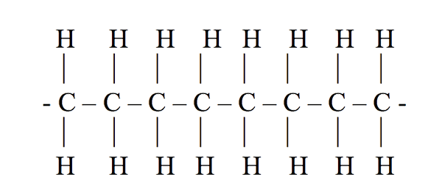
Linear Polymers
In this classification the repeated units are joined together to forme a single flexible chain looking like a spaghetti. For linear polymers, there may be extensive van der Waals and hydrogen bonding between the chains.
Examples: polyethylene, poly(vinyl chloride), polystyrene, poly(methyl methacrylate) and nylon.

Slide 15
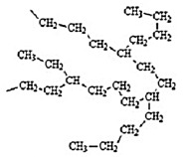
Branched polymers
Branched polymers are a synthesizing of linear polymers where side-branch chains are connected to the main ones. The branches, considered to be part of the main-chain molecule, may result from side reactions that occur during the synthesis of the polymer.
Example: High density polyethylene (HDPE) is a linear polymer, while low density polyethylene (LDPE) contains short chain branches.

Slide 16
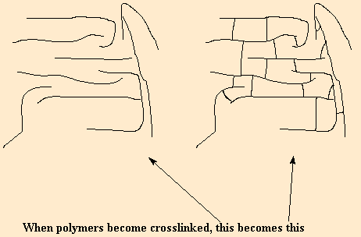
Crosslinked Polymers
Here adjacent linear chains are joined by covalent bonds to form the main polymer’s structure. The crosslinking process is given in synthesis or by a nonreversible chemical reaction.
Examples: Polybutadiene, Polyisobutylene, Polychloroprene.

Slide 17
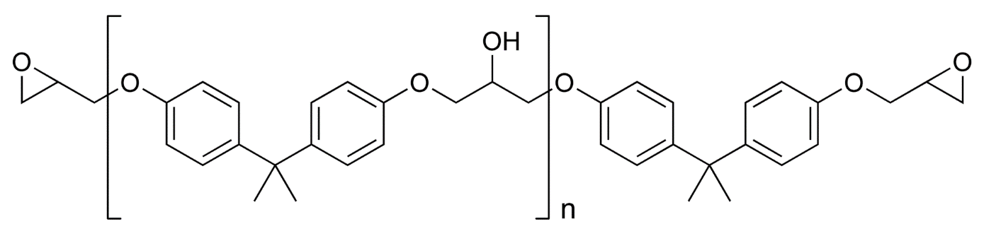
Network Polymers
Multifunctional monomers forming three or more active covalent bonds, make three-dimensional networks and are termed network polymers.
Examples: Epoxies, polyurethanes, and phenol-formaldehyde.

Slide 18
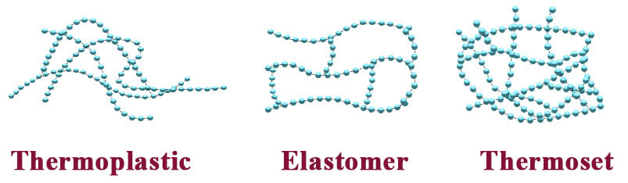
Thermoplastic and thermosetting polymers
When mechanical forces at elevated temperatures are applied in a polymer have relation with the dominant molecular structure.
Thermoplastic polymer: Thermoplastic materials are types of plastic which become soft when they are heated and hard when they cool down.
Example: Polyvinyl chloride (PVC).
Thermosetting polymers are network polymers. They become permanently hard during their formation, and do not soften upon heating.
Examples: Furan resins, Silicone, Thiolyte.

Slide 19
What is the difference between Thermoplastic and Thermosetting polymers?
Thermoplastics and thermosetting plastics are two separate classes of polymers, which are differentiated based on their behavior in the presence of heat. The material difference between the two is that thermoplastics can be remelted, while thermoset plastics remain in a permanent solid state once hardened.
VS

Slide 20
Advantages and disvantages
Advantages | Disvantages
Cheaps | Low electrical conductivity
Easy malleability | Low resistance to high temperatures
Easy fabrication | Its manufacture and use produces a lot of waste
Good mechanical resistance | They are difficult to degrade for nature
Good corrosion resistance | They are flammable, and can produce toxic gases.
Wide variety of polymers with different properties

Slide 21

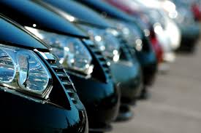
Polymer applications
Some applications of polymers can be applied in the following industries:
Automotive
Aerospace
Medical
Building
Consumer Goods
Plumbing

Slide 22
questions
Mention the classifications of the polymers seen in this class with one example
What is an hydrocarbon molecule?
What is the difference between homopolymers and copolymers?
Which are the 4 types of molecular structure in a polymer
What is the difference between Thermoplastic and Thermosetting polymers?

Slide 23
References
Collinsdictionary.com. (2018). Thermoplastic definition and meaning | Collins English Dictionary. [online] Available at: https://www.collinsdictionary.com/dictionary/english/thermoplastic [Accessed 18 May 2018].
Chemed.chem.purdue.edu. (2018). Definitions of Terms. [online] Available at: http://chemed.chem.purdue.edu/genchem/topicreview/bp/1polymer/terms.html [Accessed 18 May 2018].
Encyclopedia Britannica. (2018). Repeating unit | chemistry. [online] Available at: https://www.britannica.com/science/repeating-unit [Accessed 18 May 2018].
Materials Science and Engeneering: An introduction W.D. Calliste, Jr., 7th edition, John Wiley and Sussex, Inc. (2007).
Nature.com. (2018). [online] Available at: https://www.nature.com/articles/pj200031.pdf?origin=ppub [Accessed 18 May 2018].
Osborne Industries. (2018). The Difference Between Thermoplastic and Thermosetting Plastic. [online] Available at: https://www.osborneindustries.com/news/the-difference-between-thermoplastic-and-thermosetting-plastic/ [Accessed 18 May 2018].
Pslc.ws. (2018). Crosslinking. [online] Available at: http://pslc.ws/macrog/xlink.htm [Accessed 18 May 2018].
Sciencing. (2018). What Is a Thermoplastic Polymer?. [online] Available at: https://sciencing.com/thermoplastic-polymer-5552849.html [Accessed 18 May 2018].
ThoughtCo. (2018). What Is a Polymer? Definition and Examples. [online] Available at: https://www.thoughtco.com/definition-of-polymer-605912 [Accessed 18 May 2018].

